Slide 1
How to sync files with an upstream branch from GitHub Desktop

Slide 2
Click
Fetch Origin
to sync files

Slide 3
This indicates there are no new files

Slide 4
Click here to synch upstream files

Slide 5
Confirm that the Current Branch is correct

Slide 6
Select
Choose a branch to merge into

Slide 7
Select this branch

Slide 8
This indicates there are 13 new commits
Create a merge commit

Slide 9
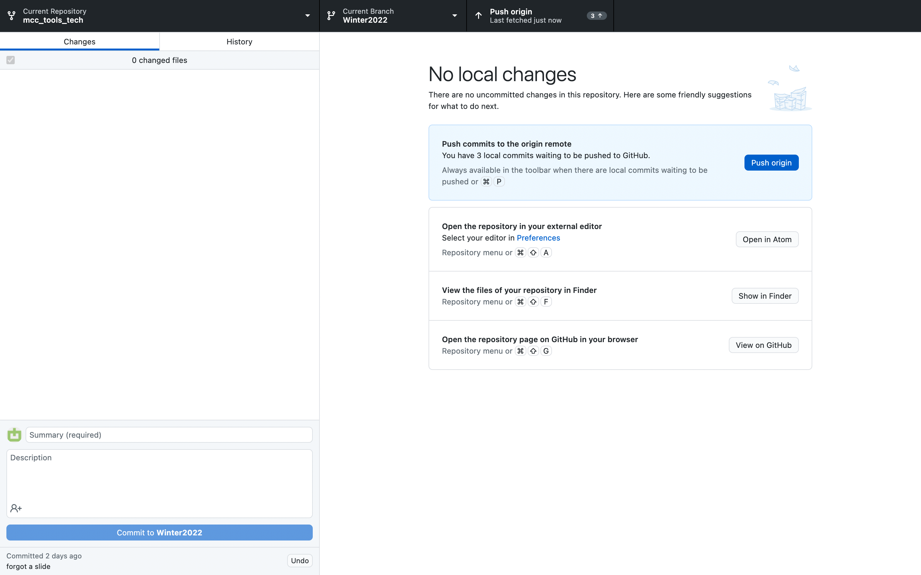
Select
Push origin

